Slide 1
Big Mountain
Executive Slide Deck

Slide 2
Problem Identification: Optimizing Pricing Strategy
Recent Challenge: Operating expenses increased by $1,540,000 due to the addition of a new chairlift.
Opportunity: Enhance revenue generation while maintaining competitiveness.
Current Limitations
Inadequate insight into the importance of specific facilities.
Hindering investment decisions and market positioning.
Our Approach
Leverage data science to make informed decisions.
Evaluate resort features and amenities.
Identify opportunities for pricing enhancement.

Slide 3
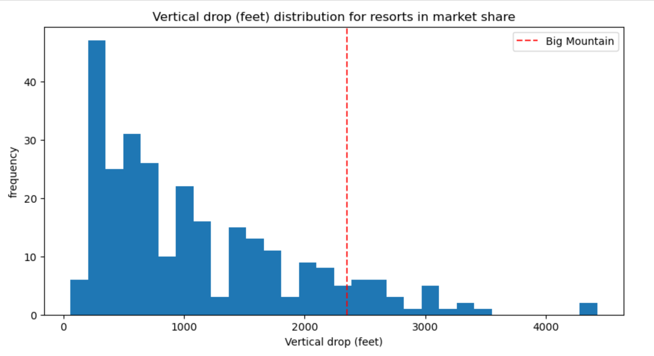
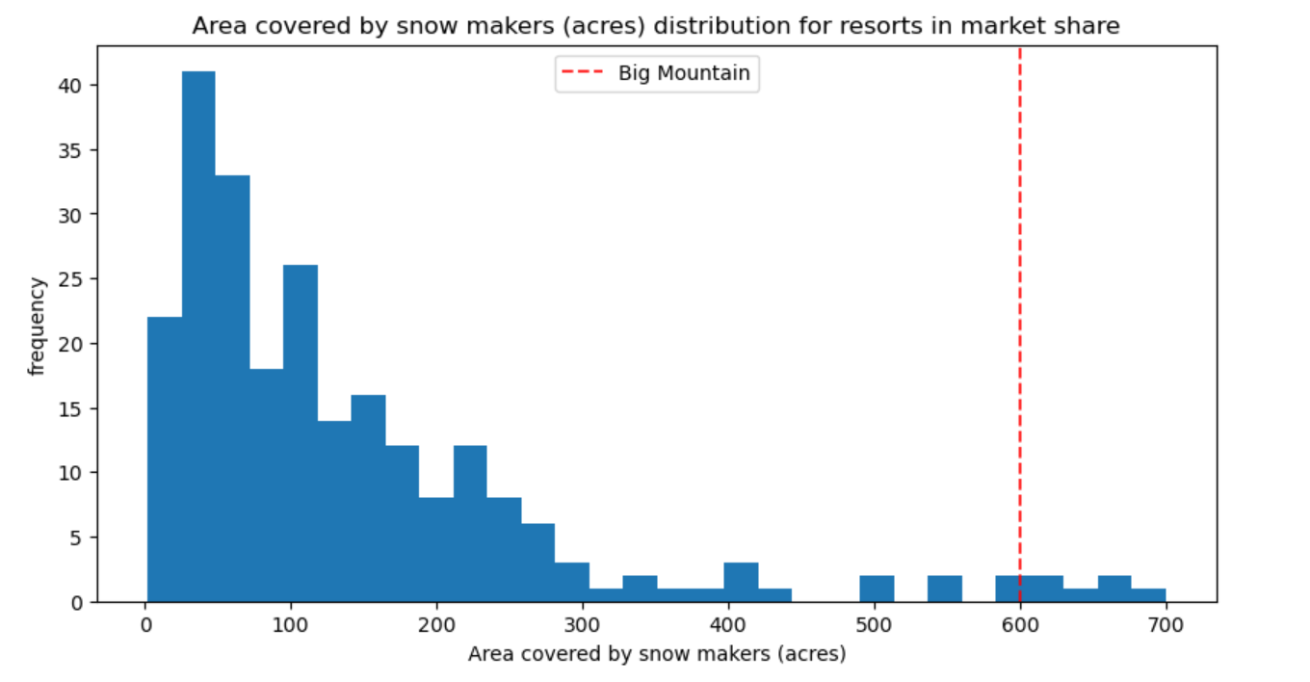
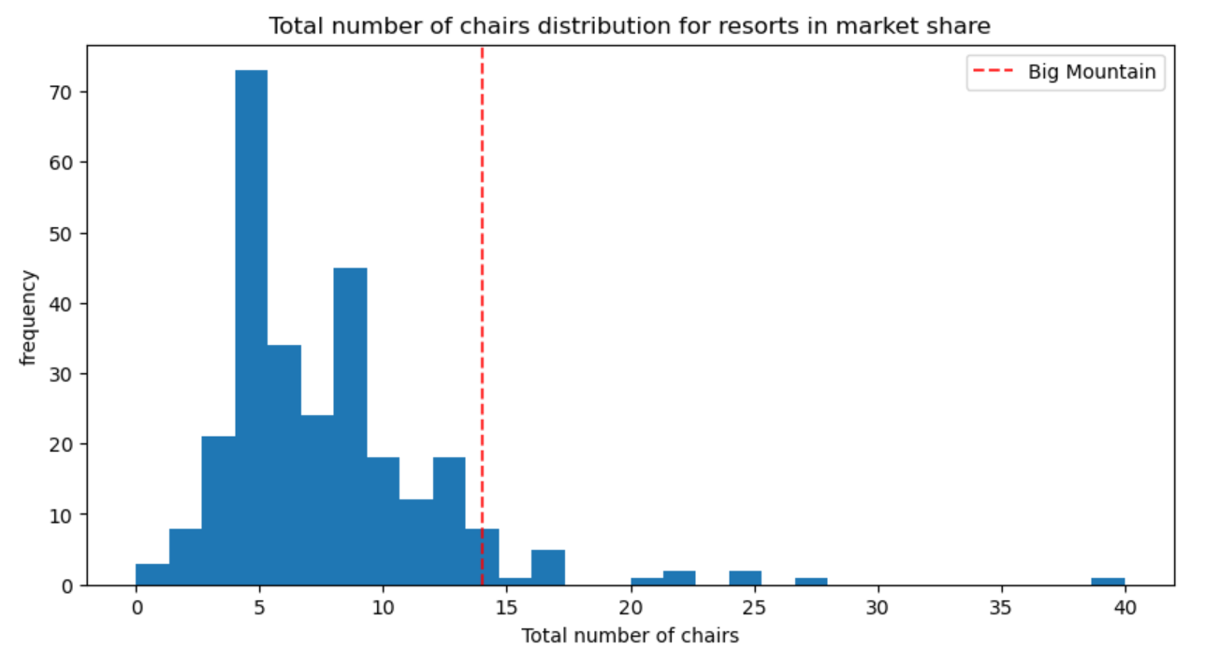
Recommendation: Pricing Strategy
Adult Weekend Ticket Price Increase: Proposed adjustment from $81 to $95.87.
Strategic Positioning: Reflects Big Mountain's exceptional amenities.
Revenue Enhancement: Anticipate substantial revenue growth.
Key Features Impacting Pricing
Vertical Drop: Big Mountain's impressive vertical drop is a key attraction, offering guests an exhilarating and unique skiing experience. Elevating the price acknowledges the premium value of this feature.
Snow Making_ac: Consistent snow coverage is essential for guest satisfaction. Big Mountain's substantial snowmaking capacity ensures a reliable skiing season, justifying a higher price point.
Total Chairs: A diverse selection of chairlifts enhances guest convenience and accessibility across the resort. An increased price recognizes the improved guest experience provided by these amenities.
FastQuads: High-speed lifts reduce waiting times and enhance the overall skiing experience. A price increase reflects the added value of these efficient transportation options.
Runs: A variety of runs caters to skiers of all skill levels, ensuring a comprehensive skiing experience. Raising the price acknowledges the diversity and quality of the skiing terrain.
LongestRun_mi: Longer runs offer guests extended enjoyment and a sense of adventure. An increased price recognizes the enhanced value provided by extended runs.
Trams: Trams provide guests with panoramic views and rapid transportation. A higher price aligns with the elevated guest experience facilitated by these premium amenities.
SkiableTerrain_ac: Big Mountain's expansive ski area allows for exploration and diverse skiing opportunities. The increased price reflects the value of this extensive terrain.

Slide 4
Modeling results- Methodology Overview
Data Cleaning: Initial data cleanup process.
Feature-Based Approach: Focus on utilizing available features for accuracy.
Missing Data Imputation: Determined optimal imputation method (median).
Data Scaling: Applied feature scaling for modeling.
Train-Test Split: Segregated data for model evaluation.
Model Selection: Explored multiple models and methods.
Statistical Evaluation: Utilized R^2 and Mean Absolute Error (MAE) for model comparison.

Slide 5
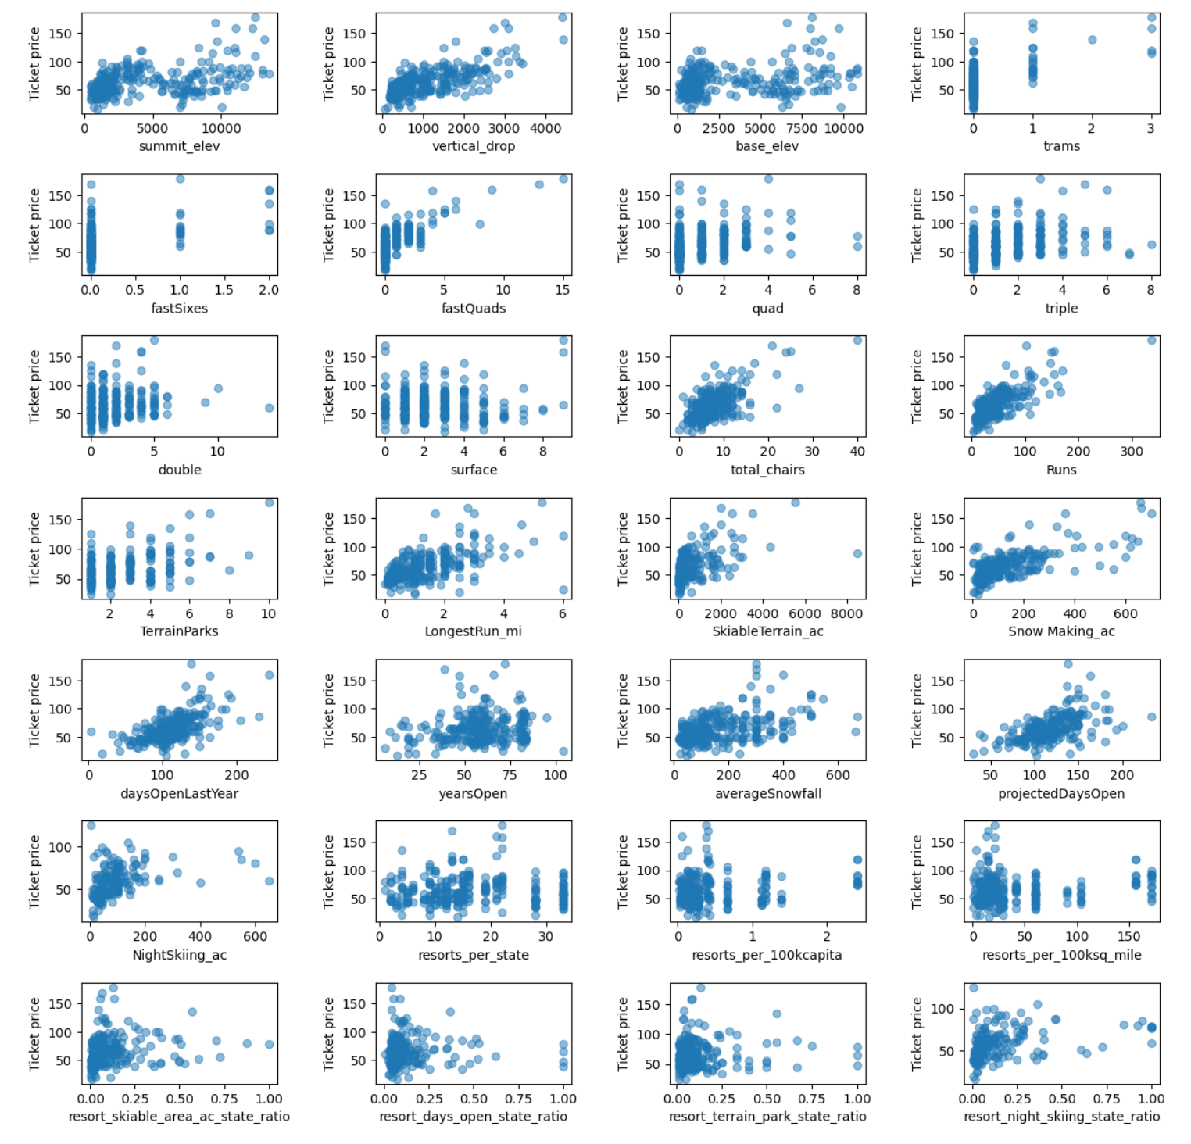
Feature Based Approach
Feature Focus: Emphasized using available features for accuracy.
Discrimination Based on Feature Availability: Prioritized feature availability over state discrimination for better results.
Feature-Based Approach
Data-Driven Feature Selection: Prioritized features based on their influence on ticket pricing.
Scatterplots Analysis: Visualized feature correlations with ticket price.
High Correlations: Identified features with strong positive correlations.
Insights Beyond Correlation Figures: Uncovered nuanced patterns in the data.
Scatterplots Analysis
Vertical_Drop: Strong positive correlation with ticket price, indicating higher pricing for greater vertical drops.
fastQuads: Evident usefulness, showcasing a positive correlation with ticket price.
Runs and Total_Chairs: Both features display similar and valuable correlations, influencing ticket pricing positively.
Resorts_per_100kcapita:
Low values show price variability, capable of both dropping and climbing.
Ticket price tends to increase as the number of resorts per capita rises.
Lower ticket prices correspond to states with fewer resorts, potentially less popular for skiing.
High prices in areas with rare resorts suggest monopoly effects due to limited competition.

Slide 6
Testing and Model Selection
Validation Process: Rigorous testing to determine the most effective pricing model.
Model Performance Metrics: Evaluation based on R^2 and Mean Absolute Error (MAE).
Final Model Selection: Opted for the Random Forest Regressor.
Confidence in Results: Data-driven model selection ensures robust pricing recommendations.
Validation Process
Data Segmentation: Split data into training and testing sets.
Model Evaluation: Rigorously assessed model performance.
Statistical Metrics: Utilized R^2 and MAE for evaluation.
Model Performance Metrics
R^2 (Coefficient of Determination):
Measures the proportion of variance in the target variable explained by the model.
Linear Regression: 0.818 (Training), 0.721 (Test).
Random Forest Regressor: Estimated 0.865 (Cross-Validation), Actual Test 0.853.
Mean Absolute Error (MAE):
Measures the average magnitude of errors between predicted and actual values.
Random Forest Regressor: Estimated 9.645 (Cross-Validation), Actual Test 9.538.
Final Model Selection
Random Forest Regressor: Chosen based on superior performance.
Cross-Validation Benefit: Confirmed model robustness.
Lowest MAE: Significantly outperformed other models in test data.

Slide 7
In Conclusion
Confidence in Results
Data-Driven Decision: The selection of the Random Forest Regressor is based on empirical evidence.
Strong Predictive Power: The model's accuracy instills confidence in pricing recommendations.
Enhanced Strategy: Ensures a solid foundation for price adjustments and business decisions.
Summary -
Our rigorous testing and model selection process culminated in the choice of the Random Forest Regressor. Its superior performance, as demonstrated through cross-validation and actual test data, reinforces our confidence in the pricing recommendation of increasing the adult weekend ticket price to $95.87.

